Slide 1
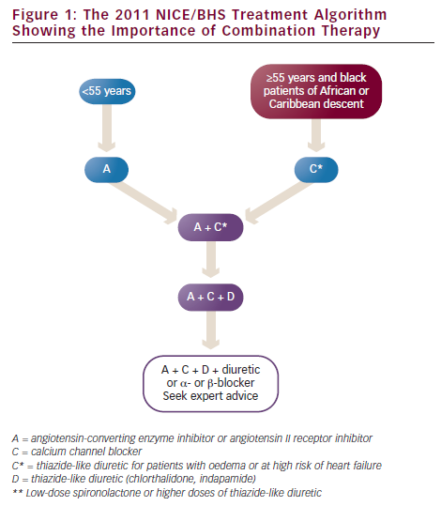
The 2011 NICE/BHS Treatment Algorithm Showing the Importance of Combination Therapy
Citation: European Cardiology 2012;8(3):192–7
https://doi.org/10.15420/ecr.2012.8.3.192

