Slide 1
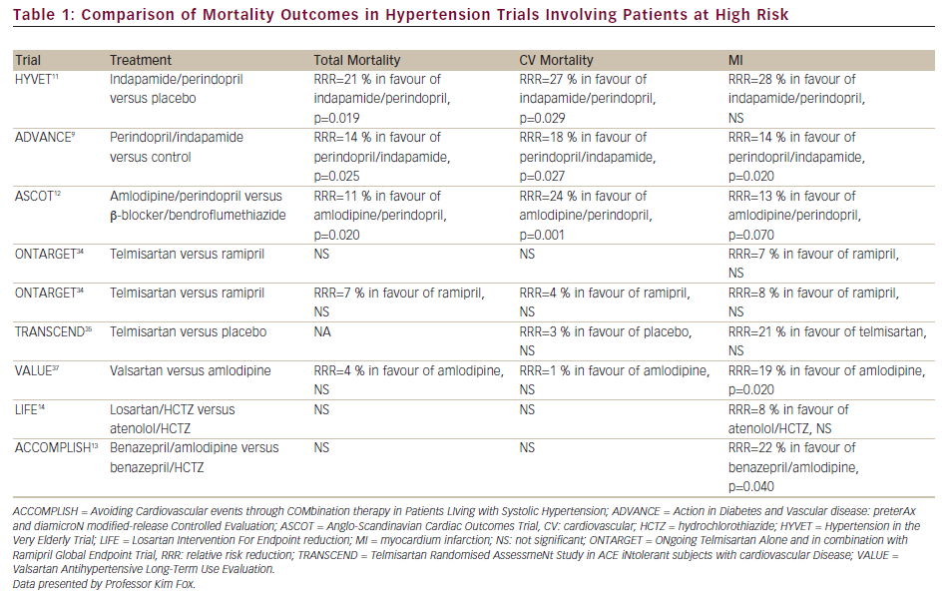
Comparison of Mortality Outcomes in Hypertension Trials Involving Patients at High Risk
Citation: European Cardiology 2012;8(3):192–7
https://doi.org/10.15420/ecr.2012.8.3.192

