Slide 1
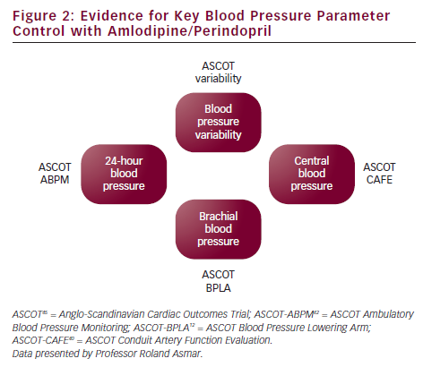
Landscape of Combination Therapy - Which Way Forward? Proceedings of the Satellite Symposium Held at the ESH European Meeting on Hypertension and Cardiovascular Protection, 27 April 2012, London
Citation: European Cardiology 2012;8(3):192–7
https://doi.org/10.15420/ecr.2012.8.3.192

