Slide 1

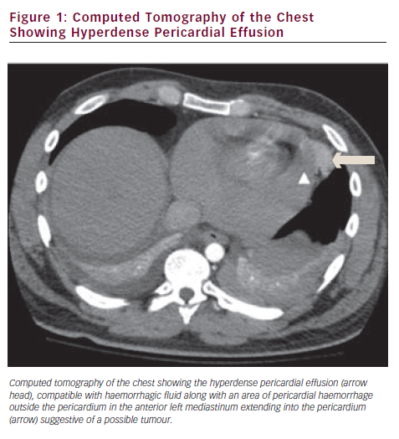
Tokala H, Kalavakunta JK, Laird-Fick H, Kamath S, Gupta V
Computed Tomography of the Chest Showing Hyperdense Pericardial Effusion
Citation: European Cardiology 2012;8(3):223–4
https://doi.org/10.15420/ecr.2012.8.3.223

