Slide 1
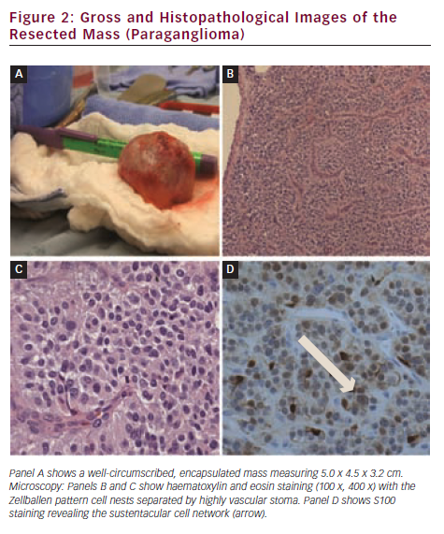
Tokala H, Kalavakunta JK, Laird-Fick H, Kamath S, Gupta V
Gross and Histopathological Images of the Resected Mass (Paraganglioma)
Citation: European Cardiology 2012;8(3):223–4
https://doi.org/10.15420/ecr.2012.8.3.223

