Slide 1
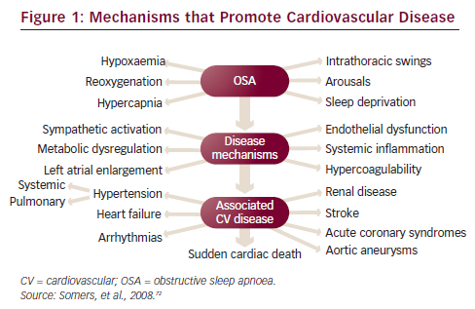
Woehrle H, Müller-Ehmsen J, Erdmann E
Mechanisms that Promote Cardiovascular Disease
Citation: European Cardiology 2012;8(3):219–22
https://doi.org/10.15420/ecr.2012.8.3.219

