Slide 1
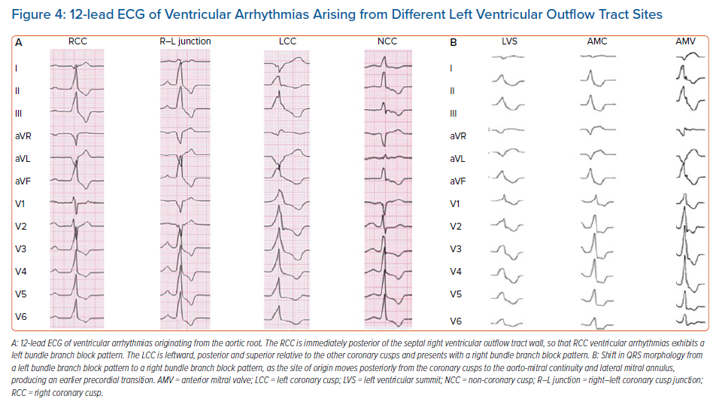
Mariani MV, Piro A, Della Rocca DG, Forleo GB, Pothineni NV, Romero JE, Di Biase L, Fedele F, Lavalle C
12-lead ECG of Ventricular Arrhythmias Arising from Different Left Ventricular Outflow Tract Sites
Citation: Arrhythmia & Electrophysiology Review 2021;10(1):10–6.
https://doi.org/10.15420/aer.2020.10

