Slide 1
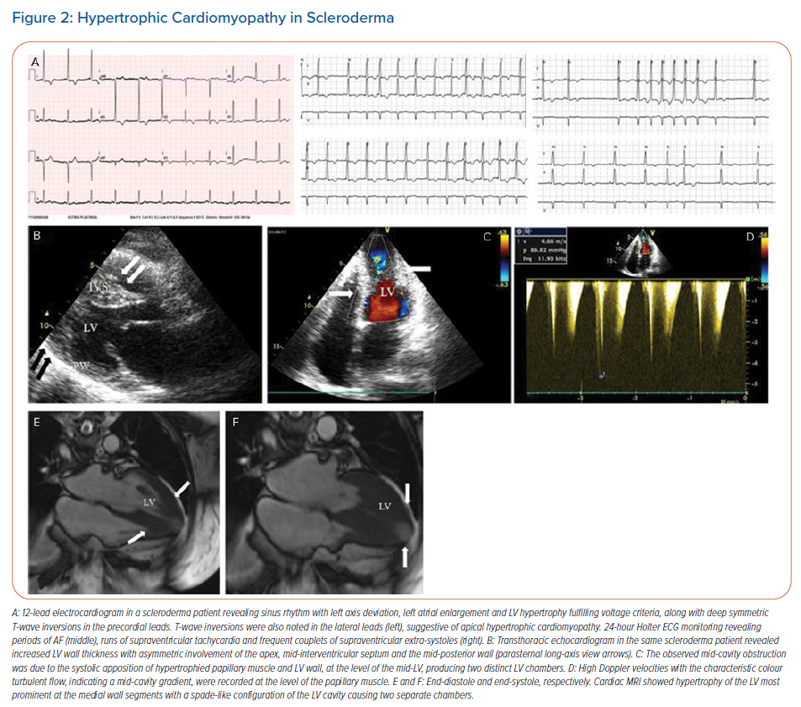
Plastiras SC, Moutsopoulos HM
Hypertrophic Cardiomyopathy in Scleroderma
Citation: Arrhythmia & Electrophysiology Review 2021;10(1):17–25.
https://doi.org/10.15420/aer.2020.43

