Slide 1
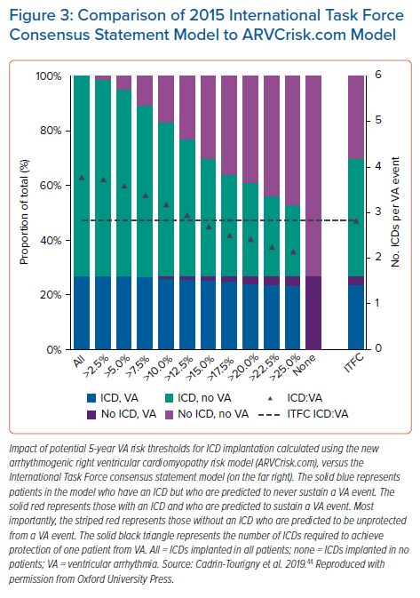
Wallace R, Calkins H
Comparison of 2015 International Task Force Consensus Statement Model to ARVCrisk.com Model
Citation: Arrhythmia & Electrophysiology Review 2021;10(1):26–32.
https://doi.org/10.15420/aer.2020.39

