Slide 1
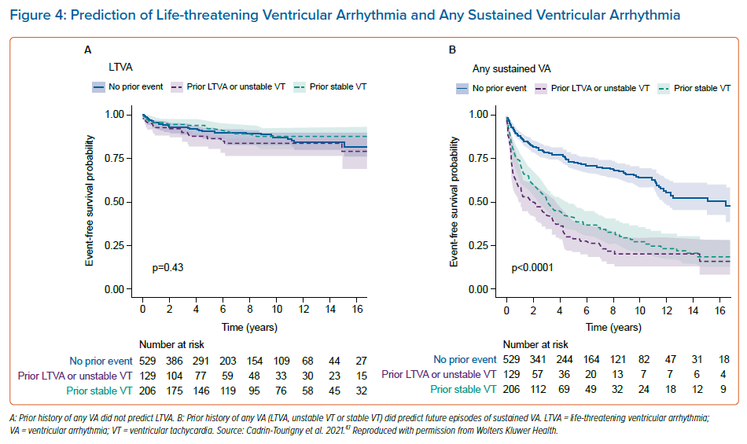
Wallace R, Calkins H
Prediction of Life-threatening Ventricular Arrhythmia and Any Sustained Ventricular Arrhythmia
Citation: Arrhythmia & Electrophysiology Review 2021;10(1):26–32.
https://doi.org/10.15420/aer.2020.39

