Slide 1
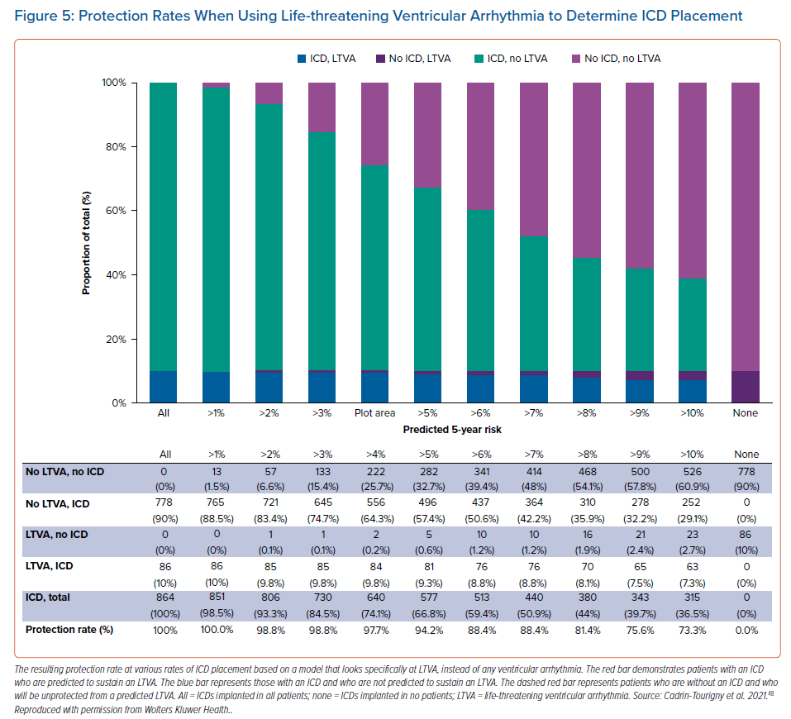
Wallace R, Calkins H
Protection Rates When Using Life-threatening Ventricular Arrhythmia to Determine ICD Placement
Citation: Arrhythmia & Electrophysiology Review 2021;10(1):26–32.
https://doi.org/10.15420/aer.2020.39

