Slide 1
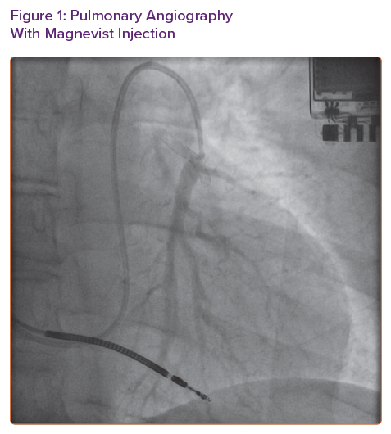
Rali AS, Stevenson LW, Zalawadiya SK
Pulmonary Angiography With Magnevist Injection
Citation: Cardiac Failure Review 2021;7:e07.
https://doi.org/10.15420/cfr.2021.03

