Slide 1
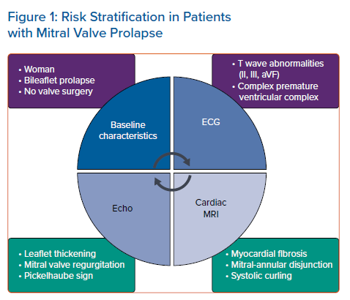
Vergara P, Altizio S, Falasconi G, Pannone L, Gulletta S, Della Bella P
Risk Stratification in Patients with Mitral Valve Prolapse
Citation: Arrhythmia & Electrophysiology Review 2021;10(1):33–7.
https://doi.org/10.15420/aer.2020.29

