Slide 1
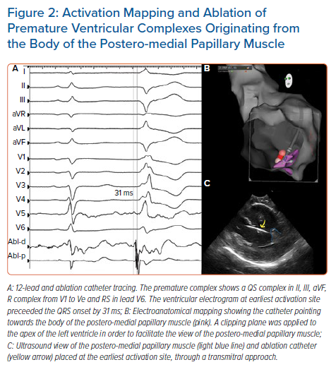
Vergara P, Altizio S, Falasconi G, Pannone L, Gulletta S, Della Bella P
Activation Mapping and Ablation of Premature Ventricular Complexes Originating from the Body of the Postero-medial Papillary Muscle
Citation: Arrhythmia & Electrophysiology Review 2021;10(1):33–7.
https://doi.org/10.15420/aer.2020.29

