Slide 1
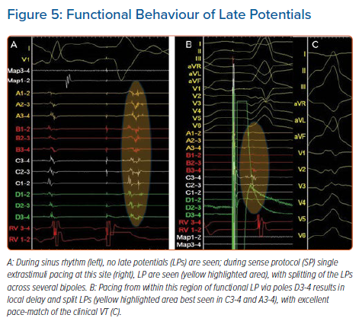
Papageorgiou N, Srinivasan NT
Functional Behaviour of Late Potentials
Citation: Arrhythmia & Electrophysiology Review 2021;10(1):38–44.
https://doi.org/10.15420/aer.2020.28

