Slide 1
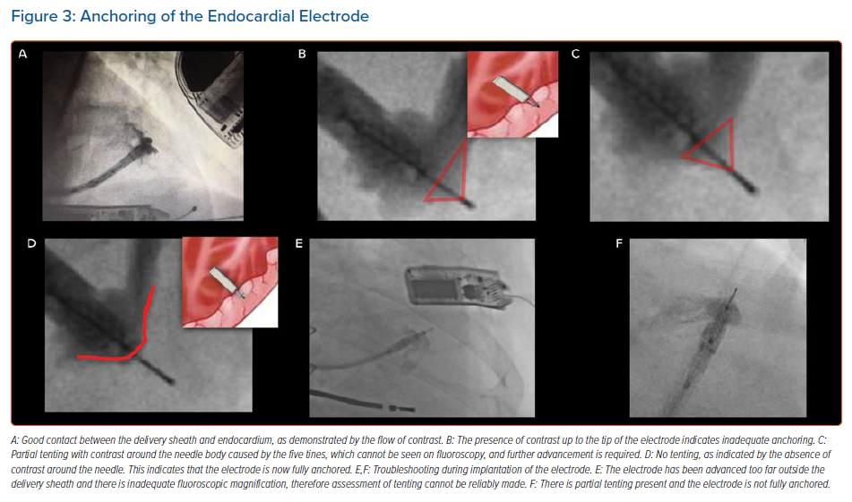
Sidhu BS, Gould J, Elliott M, Mehta V, Niederer S, Aldo Rinaldi C
Anchoring of the Endocardial Electrode
Citation: Arrhythmia & Electrophysiology Review 2021;10(1):45–50.
https://doi.org/10.15420/aer.2020.46

