Slide 1
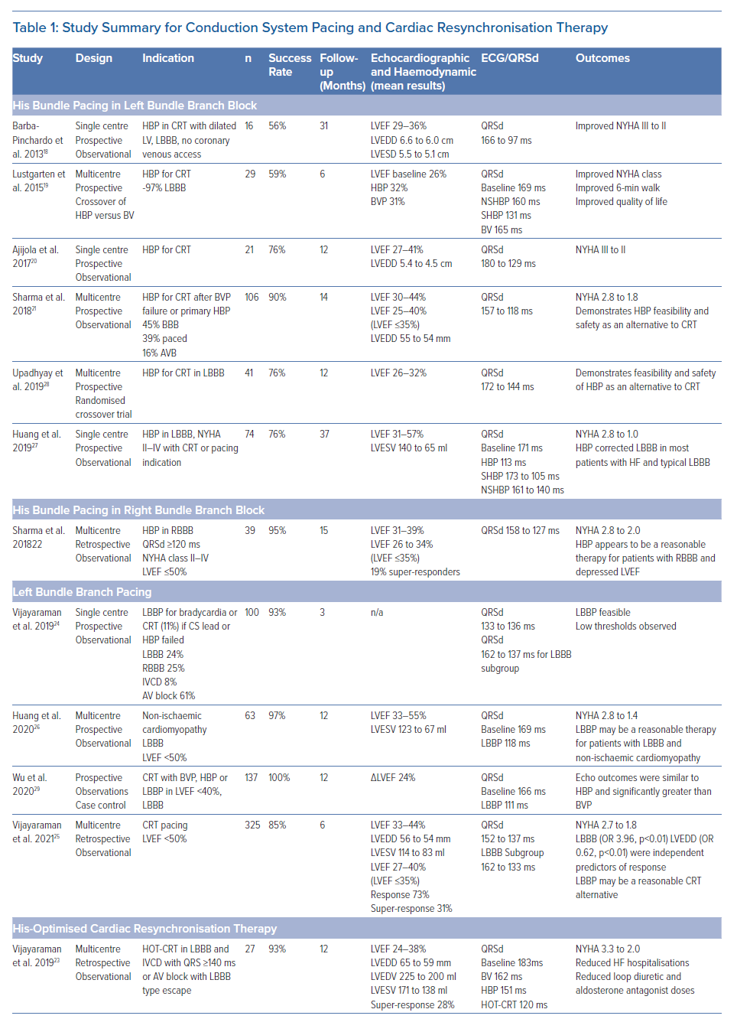
Sharma PS, Vijayaraman P
Study Summary for Conduction System Pacing and Cardiac Resynchronisation Therapy
Citation: Arrhythmia & Electrophysiology Review 2021;10(1):51–58.
https://doi.org/10.15420/aer.2020.45

