Slide 1
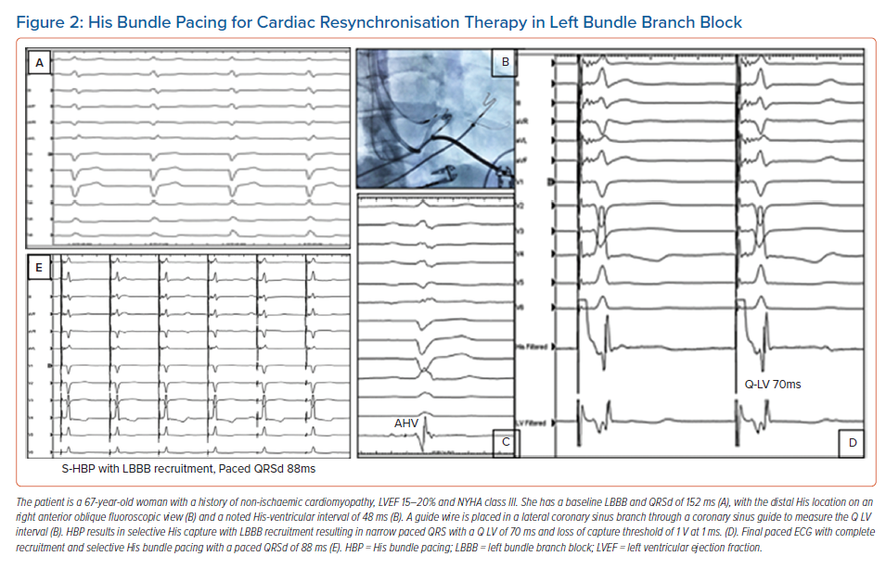
Sharma PS, Vijayaraman P
His Bundle Pacing for Cardiac Resynchronisation Therapy in Left Bundle Branch Block
Citation: Arrhythmia & Electrophysiology Review 2021;10(1):51–58.
https://doi.org/10.15420/aer.2020.45

