Slide 1
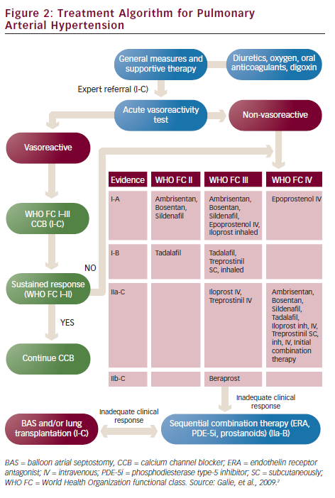
Charalampopoulos A, Gibbs JSR
Treatment Algorithm for Pulmonary Arterial Hypertension
Citation: European Cardiology 2012;8(3):213–8
https://doi.org/10.15420/ecr.2012.8.3.213

