Slide 1
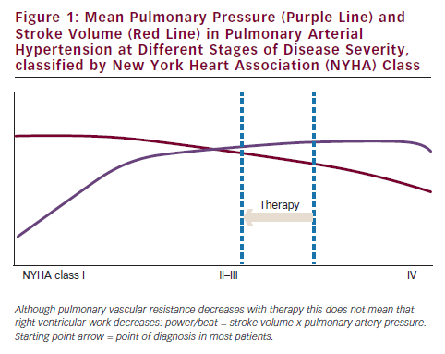
Jacobs W, Vonk-Noordegraaf A
Mean Pulmonary Pressure (Purple Line) and Stroke Volume (Red Line) in Pulmonary Arterial Hypertension at Different Stages of Disease Severity, classified by New York Heart Association (NYHA) Class
Citation: European Cardiology 2012;8(3):209–12
https://doi.org/10.15420/ecr.2012.8.3.209

