Slide 1
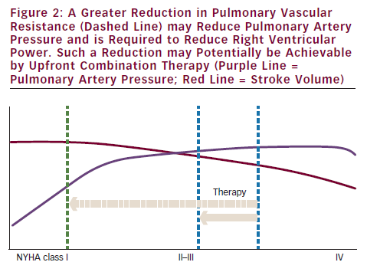
Jacobs W, Vonk-Noordegraaf A
A Greater Reduction in Pulmonary Vascular Resistance (Dashed Line) may Reduce Pulmonary Artery Pressure and is Required to Reduce Right Ventricular Power. Such a Reduction may Potentially be Achievable by Upfront Combination Therapy (Purple Line = Pulmonary Artery Pressure; Red Line = Stroke Volume)
Citation: European Cardiology 2012;8(3):209–12
https://doi.org/10.15420/ecr.2012.8.3.209

