Slide 1
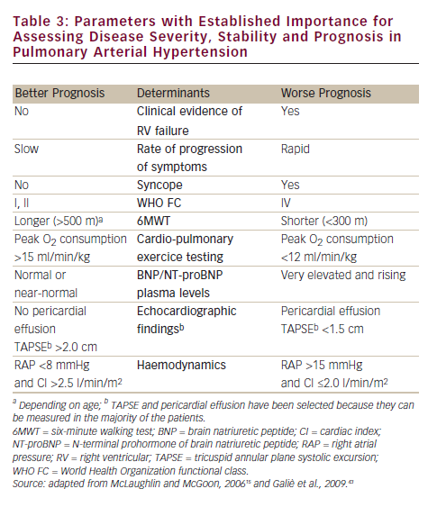
Dario Vizza C, Badagliacca R, Poscia R, Mezzapesa M, Nocioni M, Fedele F
Parameters with Established Importance for Assessing Disease Severity, Stability and Prognosis in Pulmonary Arterial Hypertension
Citation: European Cardiology 2012;8(3):198–203
https://doi.org/10.15420/ecr.2012.8.3.198

