Slide 1
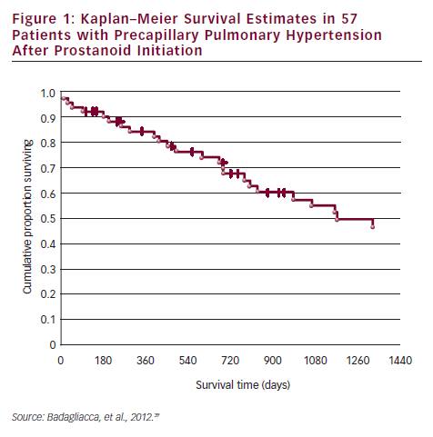
Goncalvesova E
Kaplan–Meier Survival Estimates in 57 Patients with Precapillary Pulmonary Hypertension After Prostanoid Initiation
Citation: European Cardiology 2012;8(3):204–8
https://doi.org/10.15420/ecr.2012.8.3.204

