Slide 1
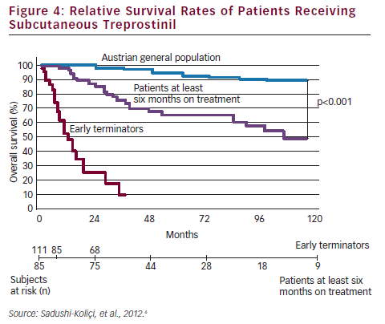
Goncalvesova E
Relative Survival Rates of Patients Receiving Subcutaneous Treprostinil
Citation: European Cardiology 2012;8(3):204–8
https://doi.org/10.15420/ecr.2012.8.3.204

