Slide 1
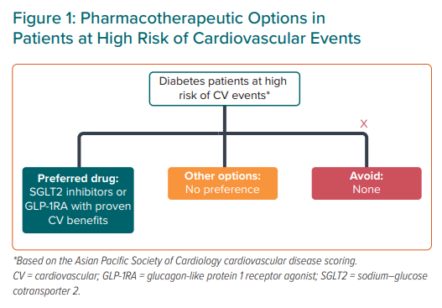
Tan JWC, Sim D, Ako J, Almahmeed W, Cooper ME, Dalal JJ, Deerochanawong C, Chun Huang DW, Johar S, Kaul U, Kim SG, Koh N, Kong APS, Krittayaphong R, Kwok B, Matawaran BJ, Nguyen QN, Ong LM, Park JJ, Peng Y, Quek D, Suastika K, Sukor N, Teo BW, Teoh CK, Zhang J, Reyes EB, Goh SY
Pharmacotherapeutic Options in Patients at High Risk of Cardiovascular Events
Citation: European Cardiology Review 2021;16:e14.
https://doi.org/10.15420/ecr.2020.52

