Slide 1
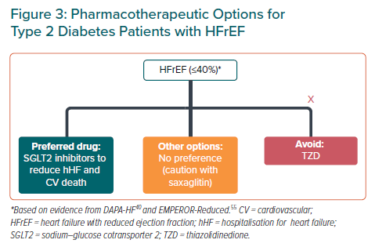
Tan JWC, Sim D, Ako J, Almahmeed W, Cooper ME, Dalal JJ, Deerochanawong C, Chun Huang DW, Johar S, Kaul U, Kim SG, Koh N, Kong APS, Krittayaphong R, Kwok B, Matawaran BJ, Nguyen QN, Ong LM, Park JJ, Peng Y, Quek D, Suastika K, Sukor N, Teo BW, Teoh CK, Zhang J, Reyes EB, Goh SY
Pharmacotherapeutic Options for Type 2 Diabetes Patients with HFrEF
Citation: European Cardiology Review 2021;16:e14.
https://doi.org/10.15420/ecr.2020.52

