Slide 1
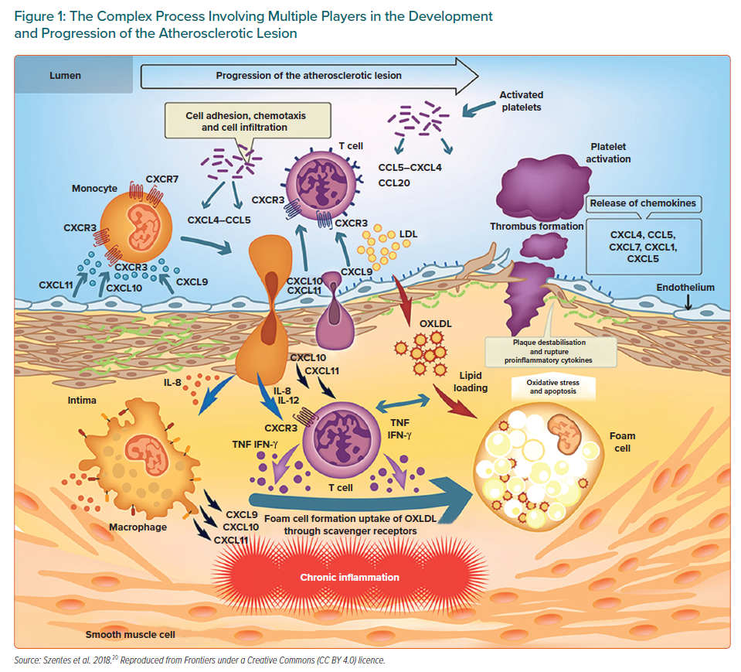
Lorenzatti A
The Complex Process Involving Multiple Players in the Development and Progression of the Atherosclerotic Lesion
Citation: European Cardiology Review 2021;16:e15.
https://doi.org/10.15420/ecr.2020.51

