Slide 1
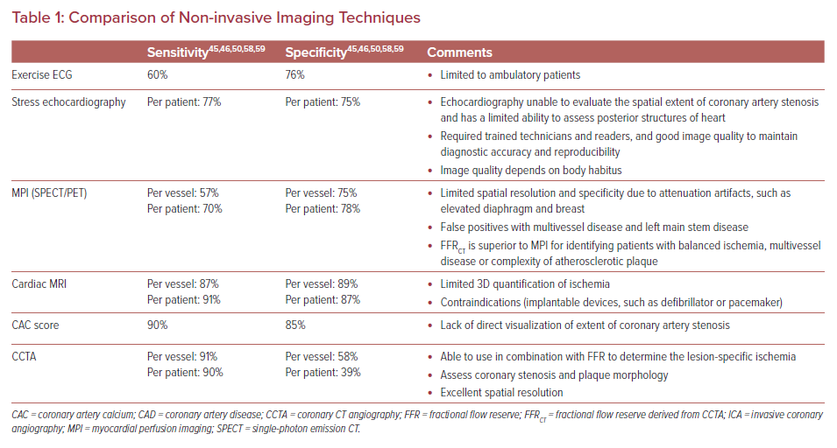
Cherukuri L, Birudaraju D, Budoff MJ
Comparison of Non-invasive Imaging Techniques
Citation: US Cardiology Review 2021;15:e06.
https://doi.org/10.15420/usc.2020.24

