Slide 1
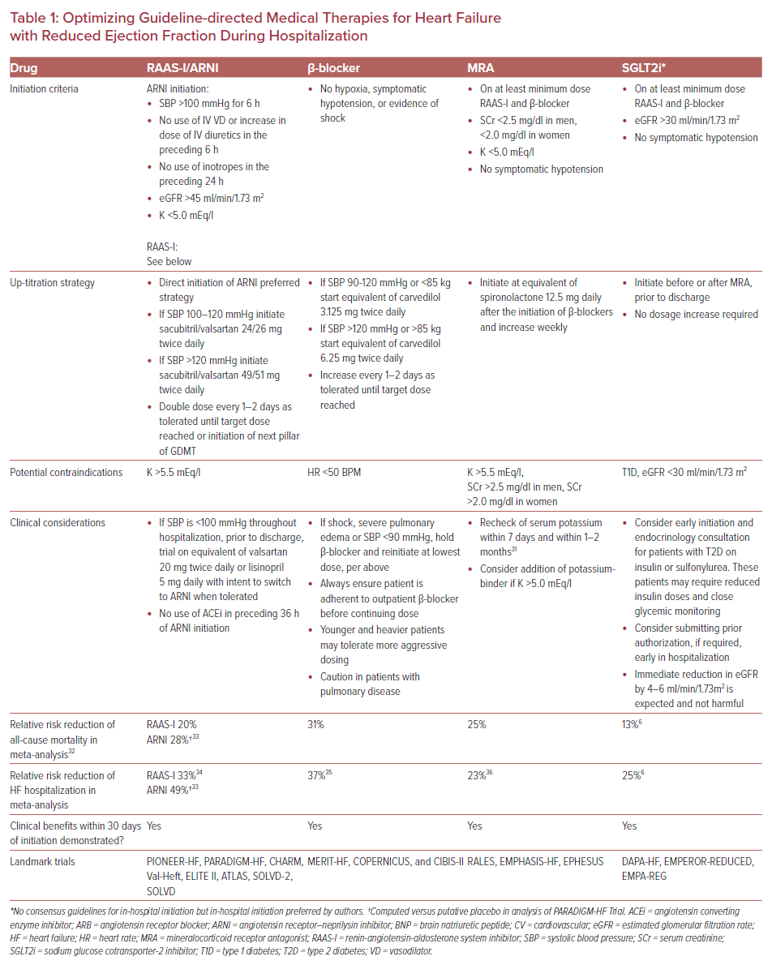
Dixit NM, Shah S, Ziaeian B, Fonarow GC, Hsu JJ
Optimizing Guideline-directed Medical Therapies for Heart Failure
Citation: US Cardiology Review 2021;15:e07.
https://doi.org/10.15420/usc.2020.29

