Slide 1
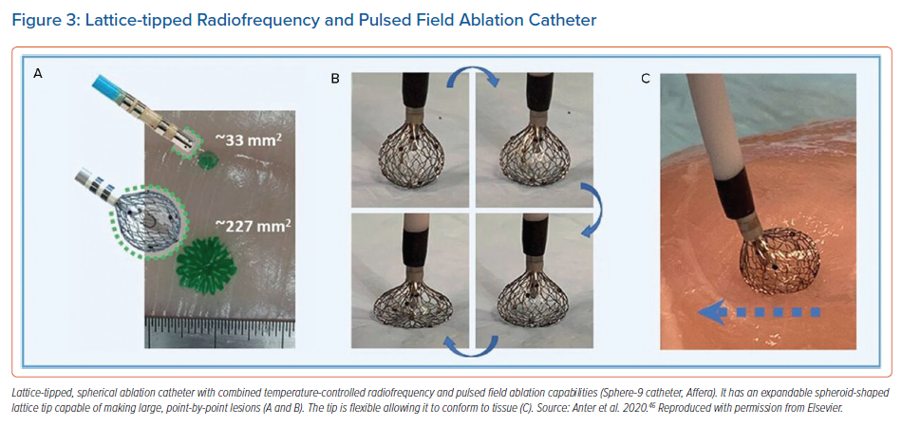
Verma MS, Terricabras M, Verma A
Lattice-tipped Radiofrequency and Pulsed Field Ablation Catheter
Citation: Arrhythmia & Electrophysiology Review 2021;10(2):101–7.
https://doi.org/10.15420/aer.2020.40

