Slide 1
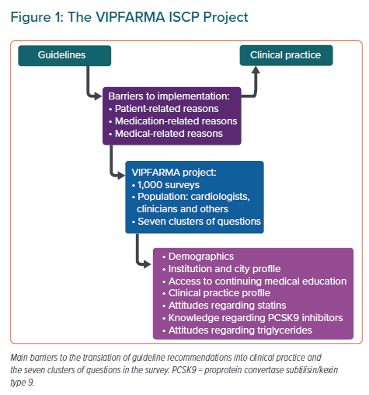
Santi RL, Martínez F, Baranchuk A, Liprandi AS, Piskorz D, Lorenzatti A, Santi MPL, Kaski JC
The VIPFARMA ISCP Project
Citation: European Cardiology Review 2021;16:e16.
https://doi.org/10.15420/ecr.2020.42

