Slide 1
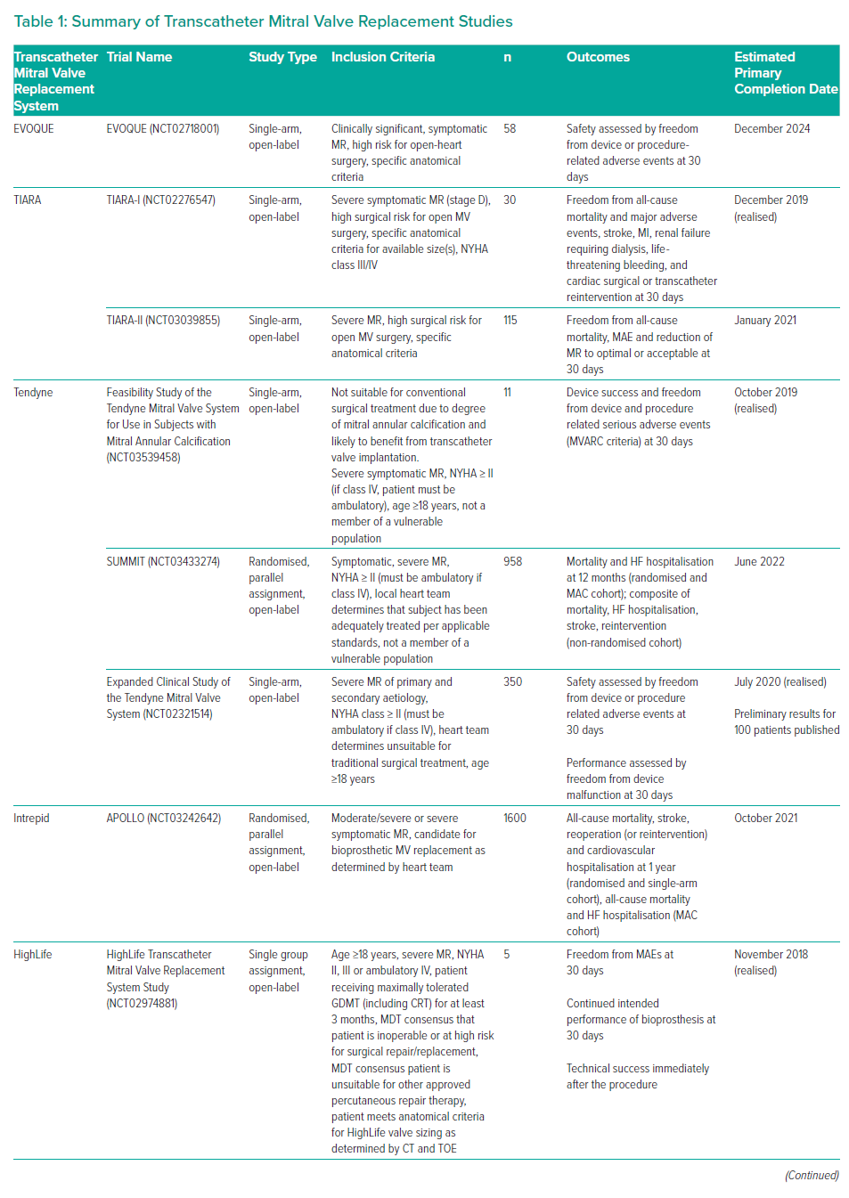
Demir OM, Bolland M, Curio J, Søndergaard L, Rodés-Cabau J, Redwood S, Prendergast B, Colombo A, Chau M, Latib A
Summary of Transcatheter Mitral Valve Replacement Studies
Citation: Interventional Cardiology Review 2021;16:e07.
https://doi.org/10.15420/icr.2020.25

