Slide 1
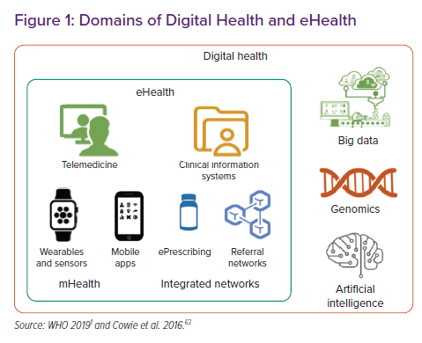
Singhal A, Cowie MR
Domains of Digital Health and eHealth
Citation: Cardiac Failure Review 2021;7:e08.
https://doi.org/10.15420/cfr.2020.28

