Slide 1
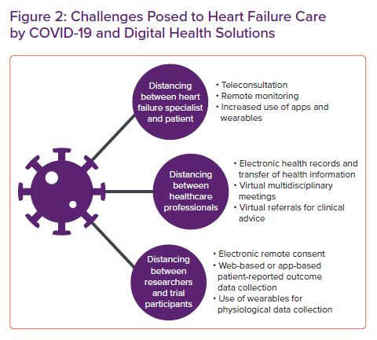
Singhal A, Cowie MR
Challenges Posed to Heart Failure Care by COVID-19 and Digital Health Solutions
Citation: Cardiac Failure Review 2021;7:e08.
https://doi.org/10.15420/cfr.2020.28

