Slide 1
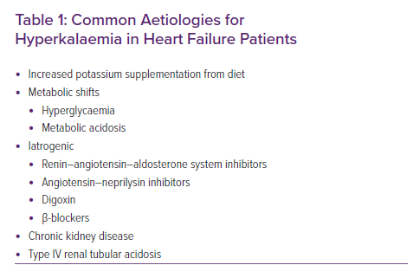
Ismail U, Sidhu K, Zieroth S
Common Aetiologies for Hyperkalaemia in Heart Failure Patients
Citation: Cardiac Failure Review 2021;7:e10.
https://doi.org/10.15420/cfr.2020.29

