Slide 1
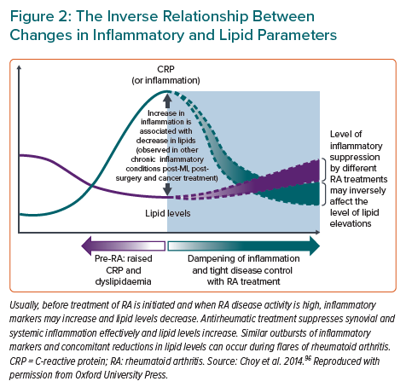
Kerola AM, Rollefstad S, Semb AG
The Inverse Relationship Between Changes in Inflammatory and Lipid Parameters
Citation: European Cardiology Review 2021;16:e18.
https://doi.org/10.15420/ecr.2020.44

