Slide 1
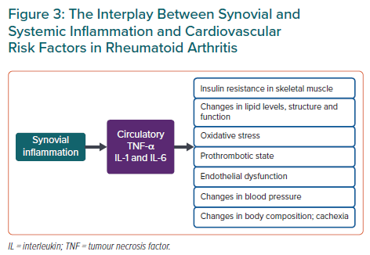
Kerola AM, Rollefstad S, Semb AG
The Interplay Between Synovial and Systemic Inflammation and Cardiovascular Risk Factors in Rheumatoid Arthritis
Citation: European Cardiology Review 2021;16:e18.
https://doi.org/10.15420/ecr.2020.44

