Slide 1
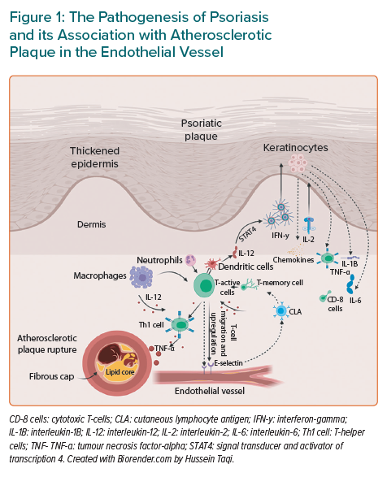
Zwain A, Aldiwani M, Taqi H
The Pathogenesis of Psoriasis and its Association with Atherosclerotic Plaque in the Endothelial Vessel
Citation: European Cardiology Review 2021;16:e19.
https://doi.org/10.15420/ecr.2020.15.R2

