Slide 1
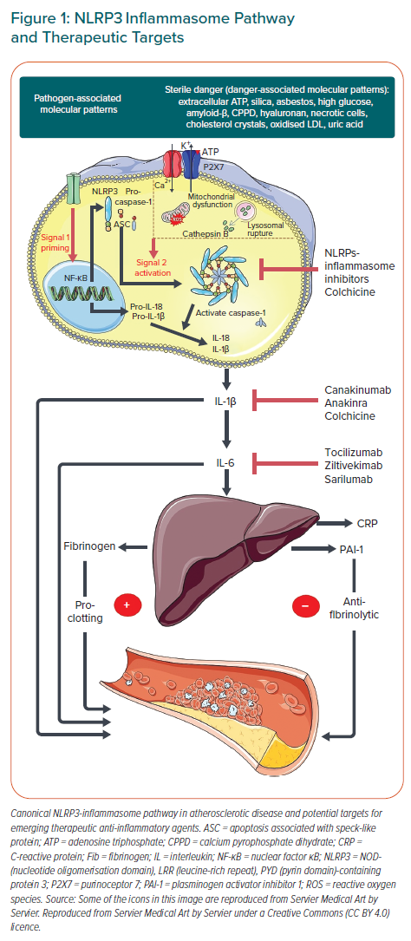
Arnold N, Lechner K, Waldeyer C, Shapiro MD, Koenig W
NLRP3 Inflammasome Pathway and Therapeutic Targets
Citation: European Cardiology Review 2021;16:e20.
https://doi.org/10.15420/ecr.2020.50

