Slide 1
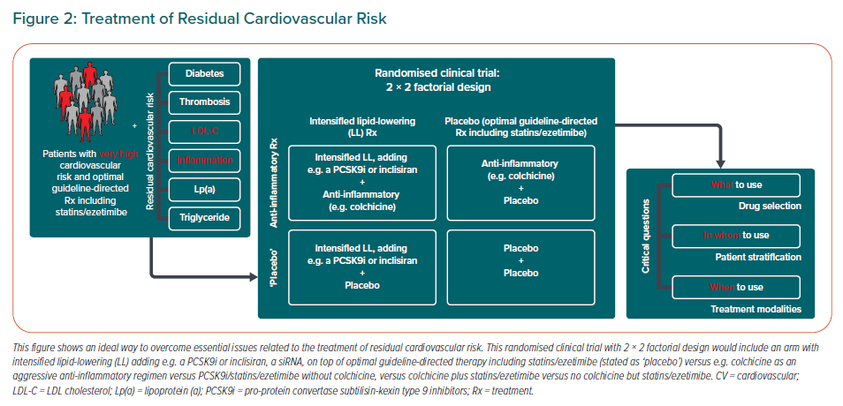
Arnold N, Lechner K, Waldeyer C, Shapiro MD, Koenig W
Treatment of Residual Cardiovascular Risk
Citation: European Cardiology Review 2021;16:e20.
https://doi.org/10.15420/ecr.2020.50

