Slide 1
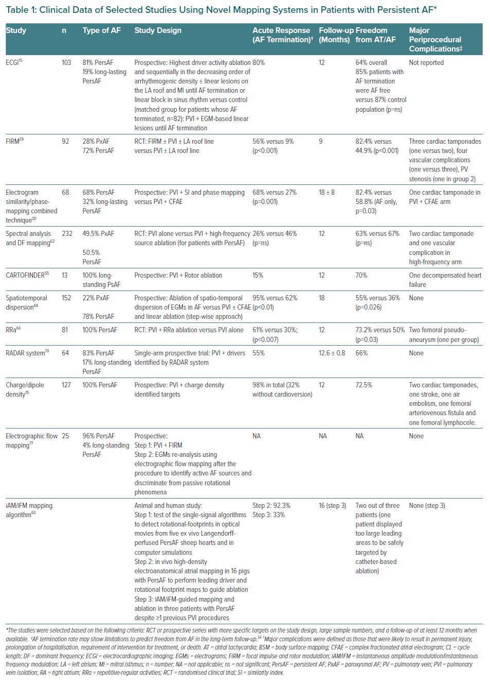
Rosa GL, Quintanilla JG, Salgado R, González-Ferrer JJ, Cañadas-Godoy V, Pérez-Villacastín J, Pérez-Castellano N, Jalife J, Filgueiras-Rama D
Clinical Data of Selected Studies Using Novel Mapping Systems in Patients with Persistent AF*
Citation: European Cardiology Review 2021;16:e21.
https://doi.org/10.15420/ecr.2020.39

