Slide 1
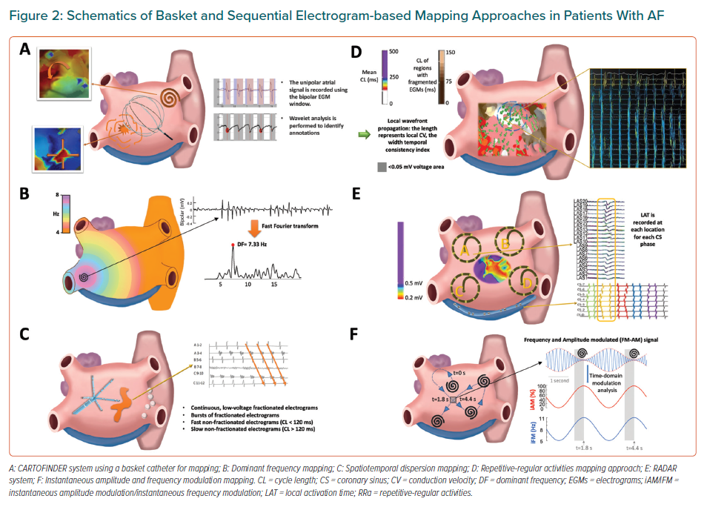
Rosa GL, Quintanilla JG, Salgado R, González-Ferrer JJ, Cañadas-Godoy V, Pérez-Villacastín J, Pérez-Castellano N, Jalife J, Filgueiras-Rama D
Schematics of Basket and Sequential Electrogram-based Mapping Approaches in Patients With AF
Citation: European Cardiology Review 2021;16:e21.
https://doi.org/10.15420/ecr.2020.39

