Slide 1
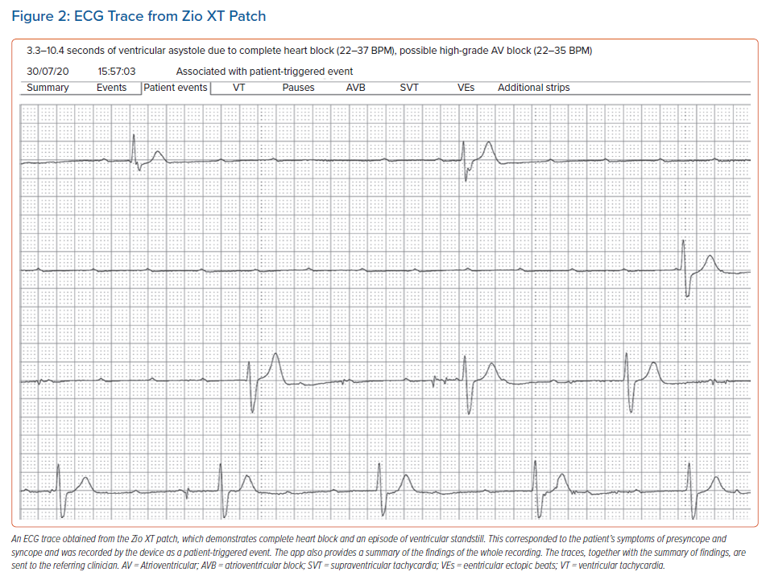
Honarbakhsh S, Sporton S, Monkhouse C, Lowe M, Earley MJ, Hunter R
ECG Trace from Zio XT Patch
Citation: Arrhythmia & Electrophysiology Review 2021;10(2):120–4.
https://doi.org/10.15420/aer.2020.37

