Slide 1
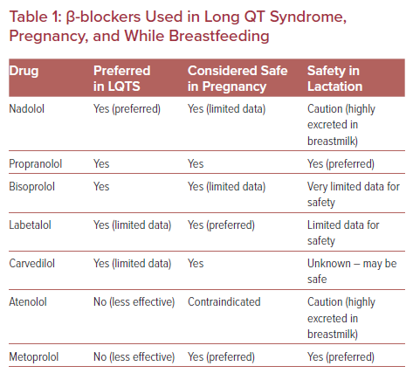
Taylor C, Stambler BS
β-blockers Used in Long QT Syndrome, Pregnancy, and While Breastfeeding
Citation: US Cardiology Review 2021;15:e08.
https://doi.org/10.15420/usc.2021.02

