Slide 1
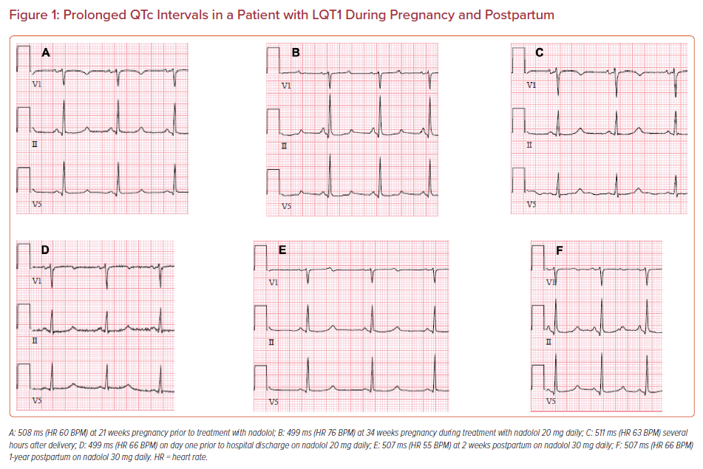
Taylor C, Stambler BS
Prolonged QTc Intervals in a Patient with LQT1 During Pregnancy and Postpartum
Citation: US Cardiology Review 2021;15:e08.
https://doi.org/10.15420/usc.2021.02

