Slide 1
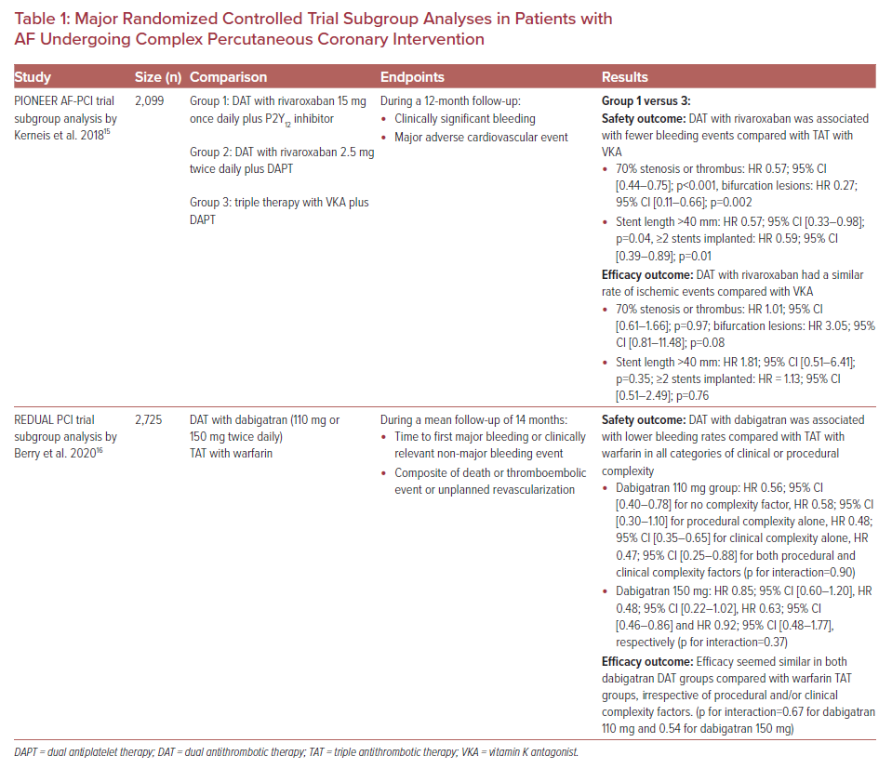
Benetou DR, Vlachakis PK, Varlamos C, Alexopoulos D
Major Randomized Controlled Trial Subgroup Analyses in Patients with AF Undergoing Complex Percutaneous Coronary Intervention
Citation: US Cardiology Review 2021;15:e09.
https://doi.org/10.15420/usc.2020.31

