Slide 1
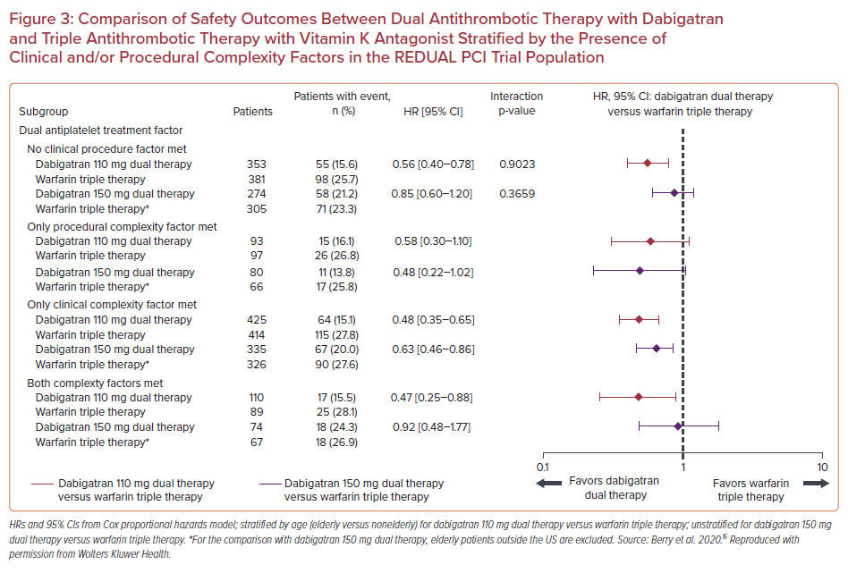
Benetou DR, Vlachakis PK, Varlamos C, Alexopoulos D
Comparison of Safety Outcomes Between Dual Antithrombotic Therapy with Dabigatran and Triple Antithrombotic Therapy with Vitamin K Antagonist Stratified by the Presence of Clinical and/or Procedural Complexity Factors in the REDUAL PCI Trial Population
Citation: US Cardiology Review 2021;15:e09.
https://doi.org/10.15420/usc.2020.31

