Slide 1
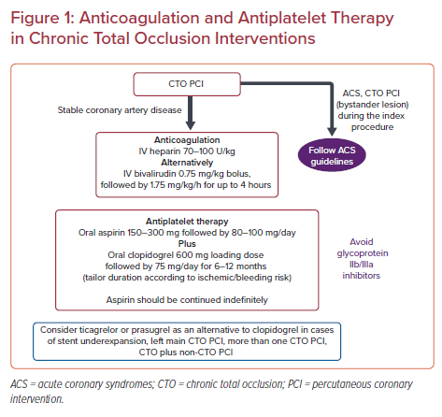
Xenogiannis I, Varlamos C, Benetou DR, Alexopoulos D
Anticoagulation and Antiplatelet Therapy in Chronic Total Occlusion Interventions
Citation: US Cardiology Review 2021;15:e10.
https://doi.org/10.15420/usc.2020.37

