Slide 1
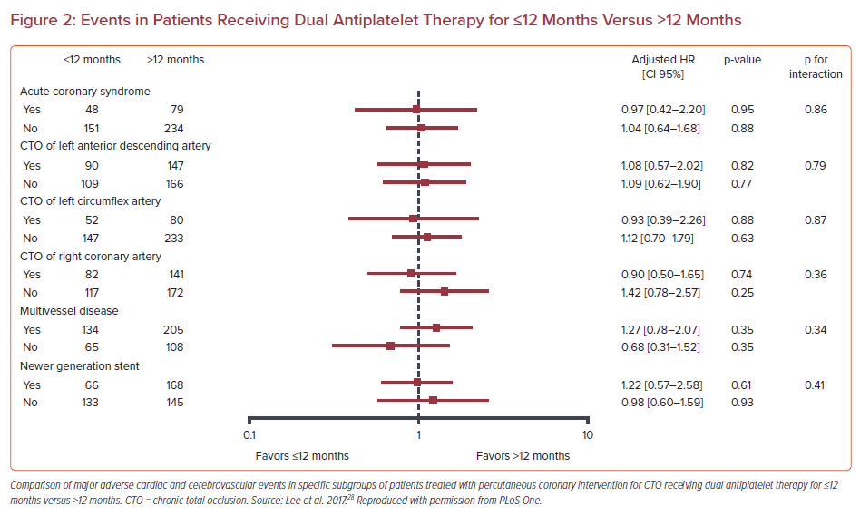
Xenogiannis I, Varlamos C, Benetou DR, Alexopoulos D
Events in Patients Receiving Dual Antiplatelet Therapy for ≤12 Months Versus >12 Months
Citation: US Cardiology Review 2021;15:e10.
https://doi.org/10.15420/usc.2020.37

