Slide 1
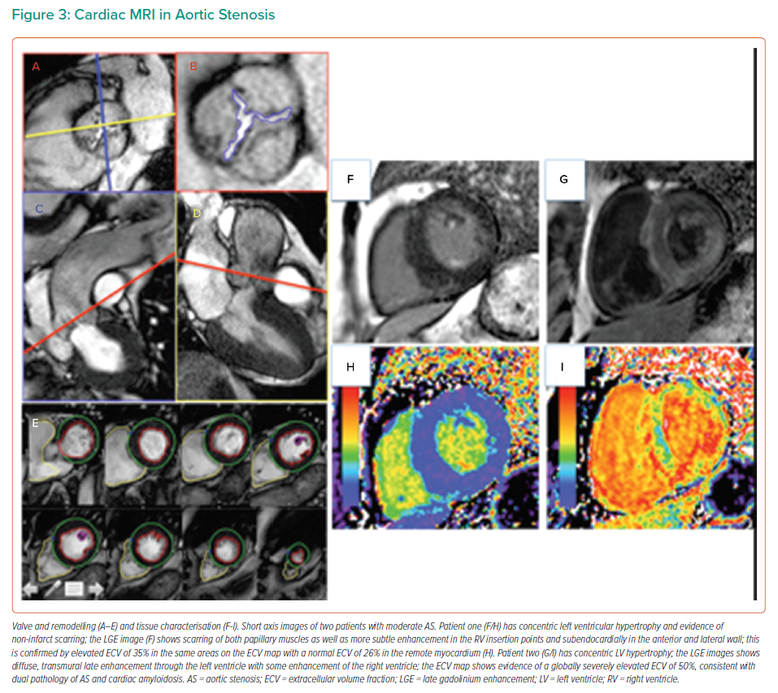
Badiani S, Bhattacharyya S, Aziminia N, Treibel T, Lloyd G
Cardiac MRI in Aortic Stenosis
Citation: Interventional Cardiology Review 2021;16:e09.
https://doi.org/10.15420/icr.2021.04

